Slide 1

Indoor Localization using Alexa
Sai Sharmila Bonam
Bhargav Santosh Areti
Praneeth Reddy Thumma
Lalu Kishore
Sneha Boddu
Sivender Pammi
Riddhima Singh
Venkatesh Malapati
Vamsi Vardan Mummadi

Slide 2

Introduction
Indoor localization using Alexa is an Internet of Things (IoT) project that aims to provide users with a smart, voice-enabled solution for locating and navigating within indoor spaces. The project leverages the capabilities of Amazon's Alexa voice assistant to enable users to detect their phones in real-time. By combining IoT technologies such as sensors, Wi-Fi, and cloud computing, this project provides an innovative and convenient solution for indoor localization.

Slide 3

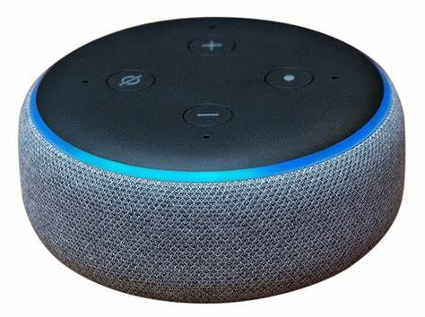


Block Diagram
Gets Rssi Signals and Uses Traingularization method
Hello Alexa, track my phone
Detects the mobile location

Slide 4

Implementation The system uses various sensors such as Wi-Fi access points, ESP 32 Devices to detect a mobile within an indoor space. These sensors are strategically placed throughout the building to ensure comprehensive coverage. The sensor data is transmitted to a cloud-based server, which processes the data and determines the mobile location using EC2 instance. The system is integrated with Amazon's Alexa voice assistant, which enables users to ask for directions or information about their current location using natural language commands. The integration with Alexa's voice assistant adds an additional layer of functionality and ease of use, making the project an innovative and practical IoT solution for indoor localization

Slide 5

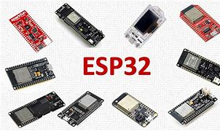
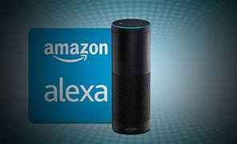
Technologies

Slide 6
Applications
Security: In high-security environments such as government buildings or research labs, indoor localization can be used to detect unauthorized mobile phones and prevent potential security breaches.
Education: In educational institutions, indoor localization can be used to detect the presence of mobile phones during exams or in areas where their use is not allowed.
Workplaces: In workplaces, indoor localization can be used to detect the presence of mobile phones in areas where their use is prohibited, such as manufacturing plants, chemical plants, or construction sites.
Event management: In events such as concerts or conferences, indoor localization can be used to detect the presence of mobile phones in areas where their use is not allowed, such as backstage or speaker preparation areas.

Slide 7
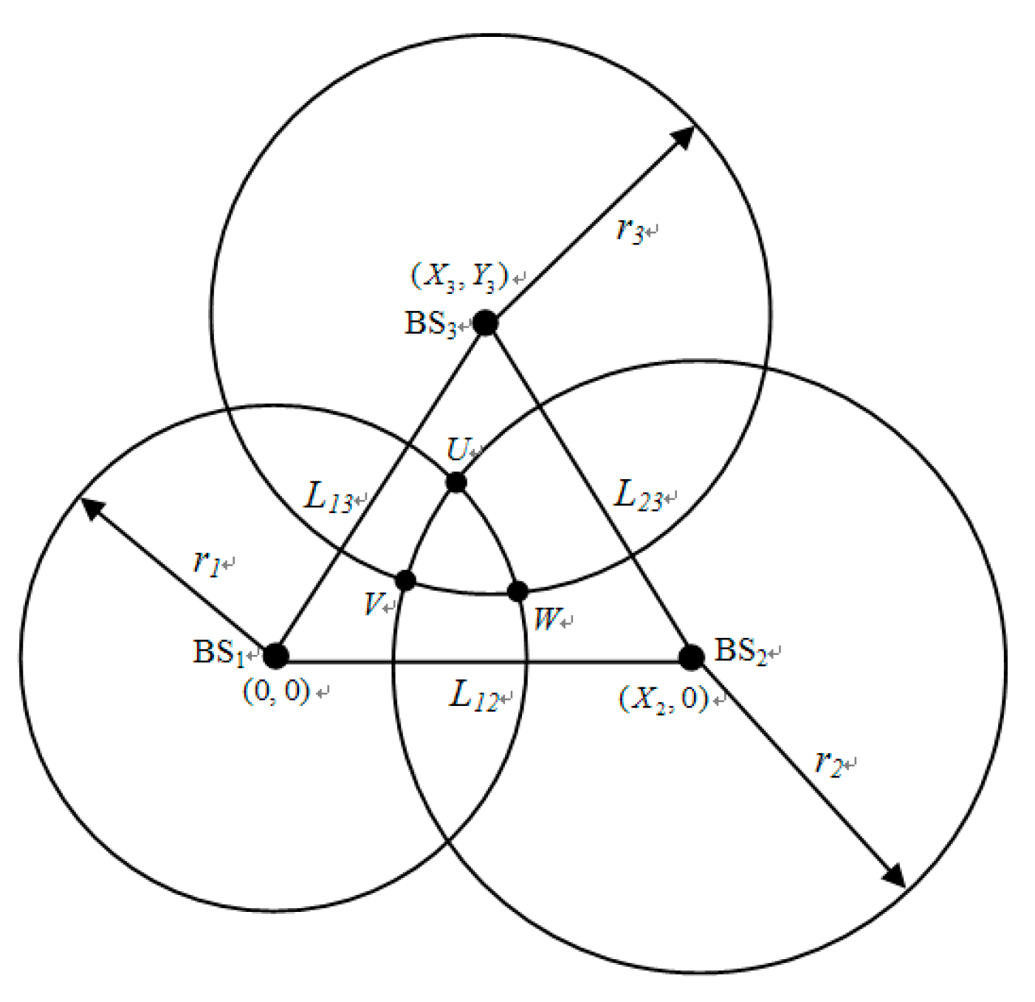
RSSI Triangulation
Received signal strength indication(RSSI) – Measurement of power.
Triangulation: It is a method for calculating a position that relies on a known distance between two measuring apparatuses and the measured angles from those two points to an object. This works using the angle-side-angle triangle congruency theorem to the find the location of an object.

Slide 8
Pros & Cons
Pros:
Enhanced security: By detecting the presence of mobile phones, indoor localization can enhance security and prevent potential security breaches in high-security environments.
Improved safety: In healthcare facilities and other sensitive environments, detecting mobile phones can help ensure patient safety by reducing the risk of interference with medical equipment.
Increased compliance: Indoor localization can help enforce regulations and policies related to the use of mobile phones in various settings, such as educational institutions and workplaces.
Real-time monitoring: Indoor localization can provide real-time monitoring of mobile phone activity, enabling quick response to potential security breaches or safety concerns.
Convenience: Using Alexa voice assistant to detect mobile phones can offer a convenient and hands-free solution for detecting mobile phones in various settings.
Cons:
Privacy concerns: Indoor localization can raise privacy concerns if personal data such as mobile phone usage is monitored and tracked without consent.
Technical limitations: The accuracy of indoor localization can be affected by various factors such as the number and placement of sensors, obstacles in the environment, and signal interference.
Cost: Setting up an indoor localization system with Alexa can be expensive, requiring investment in hardware, software, and cloud computing resources.
Reliance on cloud computing: Indoor localization systems that use Alexa typically rely on cloud computing resources, which may be vulnerable to service disruptions or security breaches.
Limited functionality: Using Alexa to detect mobile phones may offer limited functionality compared to other methods such as mobile device management software.

Slide 9

Thank you

